Slide 1
Introduction to
Electronics
Lecture 1 : Introduction
1

Slide 2
About Me
Dr. Roger Ahiadormey
Research Scientist, CSIR-INSTI
Research interests: Internet-of-Things, Wireless Communications, Tiny Machine Learning
Email: rogerkwao@gmail.com
Website: https://sites.google.com/view/rogerkwao/home
2

Slide 3
Course Overview
This course equips you to understand, build, measure, and program basic electronic circuits using fundamental components.
Reading Materials
The Art of Electronics (Hardcover) by Paul Horowitz, Winfield Hill (1989): Cambridge University Press: ISBN 978-0-521-37095
Practical Electronics for Inventors: Paul Scherz: McGraw Hill (2000): ISBN-13: 978-0070580787
Basic Electronics: Theory and Practice: Sean Westcott & Jean Riescher Westcott: Packt Publishing (2023): ISBN-13: 978-1836643326
3

Slide 4
Useful Links
https://www.khanacademy.org/science/electrical-engineering
https://www.tinkercad.com/
https://www.allaboutcircuits.com/textbook/
https://www.open.edu/openlearn/science-maths-technology/an-introduction-electronics/content-section-0?active-tab=description-tab
https://everycircuit.com/
4

Slide 5
Assessment & Grading
Homework
Quiz/Midsem
Exam
5

Slide 6
Why Electronics
Every computer program ultimately runs on physical hardware
IoT, robotics, and embedded systems are growing career fields across Africa
Understanding sensors and actuators lets you bridge software and the physical world
Debugging hardware-software interactions requires knowing both sides
Mobile app developers, data engineers, and AI practitioners all benefit from understanding signals and power
6

Slide 7
Basic Elements of Electronics
Electronics can be broken into four stages of learning:
1. Theory — Voltage, current, resistance, capacitance, inductance, and the laws that predict circuit behaviour
2. Passive Components — Resistors, capacitors, inductors, transformers
3. Active Devices — Diodes and transistors
4. Complete Circuits — Rectifiers, amplifiers, oscillators, voltage regulators
7

Slide 8
Discrete Passive Circuits
Passive circuits use only resistors, capacitors, and inductors. Common types:
Current-limiting circuits — A resistor in series limits the current flowing to a device (e.g., protecting an LED)
Voltage dividers — Two resistors in series split a voltage into a smaller proportion
Filters — circuits that pass certain frequencies and block others (low-pass, high-pass, band-pass)
Attenuators — Resistor networks that reduce signal amplitude without changing its shape
8

Slide 9
Discrete Active Devices
Active devices can amplify signals or act as switches. They are made from semiconductors.
Diodes
Allow current to flow in one direction only. Used for rectification (AC to DC convertors), and voltage regulation.
Transistors
Three-terminal devices that act as electronic switches or amplifiers. A small input signal controls a larger output. Types include BJT and MOSFET. Billions of transistors make up every microprocessor.
9

Slide 10
Transducers (Input and Output devices)
Transducers convert a signal in one form of energy to a signal in another
A signal is a quantity that varies over time and carries information.
Input devices (sensors) convert physical signals, such as sound, light, and pressure, into electrical signals that circuits can use
Output devices convert electrical signals into physical signals
These I/O devices allow humans and circuits to communicate with one another.
10

Slide 11
Input Devices — Sensors
Device | Converts | Typical Use
Microphone | Sound → Voltage | Audio recording, voice control
Phototransistor | Light → Current | Light sensing, optical communication
Switch / Button | Mechanical → On/Off | User input, limit detection
Thermistor | Temperature → Resistance | Temperature monitoring
Antenna | EM waves → Voltage | Radio, WiFi, Bluetooth
11

Slide 12
Output Devices — Actuators
Device | Converts | Typical Use
Lamp / LED | Voltage → Light | Indicators, displays, lighting
LCD / OLED Display | Voltage → Pixels | Screens, readouts
Speaker | Voltage → Sound | Audio output, alarms
DC Motor | Voltage → Rotation | Fans, wheels, pumps
Servo Motor | PWM signal → Angle | Robotics
Stepper Motor | Pulses → Precise steps | 3D printers, CNC machines
Solenoid | Voltage → Linear push/pull | Door locks, valves
12

Slide 13
PART 2
Electric Current
The Flow of Charge
13

Slide 14
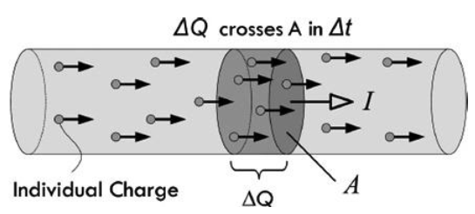
Electric Current — Definition
Electric current is the rate at which electric charge flows past a point in a circuit.
I = ΔQ / Δt
where I = current (amperes), ΔQ = charge (coulombs), Δt = time (seconds)
One ampere = one coulomb of charge per second (1 A = 1 C/s )
In a copper conductor, electrons move through the metal lattice when a voltage is applied
14

Slide 15
Electron Charge & Count
Each electron carries a charge of:
e = 1.602 × 10⁻¹⁹ coulombs
This means one coulomb requires about 6.24 × 10¹⁸ electrons.
At a current of 1 A, roughly 6.24 billion billion electrons pass a point every second.
Even a tiny current of 1 mA involves about 6.24 × 10¹⁵ electrons per second — the numbers are immense at the atomic scale.
15

Slide 16
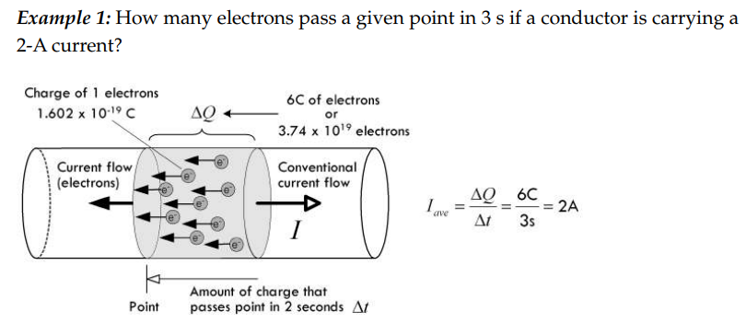
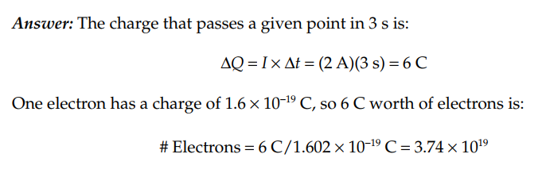
Calculating Electron Flow Through a Conductor
16

Slide 17
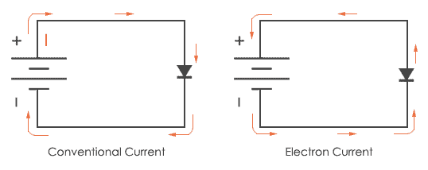
Conventional vs. Electron Flow
Conventional current (used in circuit analySsis)
This is the standard used in textbooks, schematics, and engineering.
Electron flow (physical reality)
Electrons actually move from − terminal to + terminal. This was discovered after the convention was already established.
I
17

Slide 18
Unit Prefixes for Current & Voltage
Prefix | Symbol | Factor | Example
Amp | A | 1 | 1 A = household appliance
Milliamp | mA | 10⁻³ | 20 mA = typical LED
Microamp | µA | 10⁻⁶ | 1 µA = sleep-mode MCU
Nanoamp | nA | 10⁻⁹ | 1 nA = op-amp input bias
Kilovolt | kV | 10³ | 11 kV = power lines
Millivolt | mV | 10⁻³ | 1 mV = ECG signal
Microvolt | µV | 10⁻⁶ | 10 µV = EEG brain signal
Kilo-ohm | kΩ | 10³ | 4.7 kΩ = common resistor
Mega-ohm | MΩ | 10⁶ | 10 MΩ = multimeter input
18

Slide 19
Currents in Perspective
Context | Typical Current
Microchip standby | A few pA to µA
Digital watch | ~1 µA
Smartphone (idle) | ~10 mA
LED indicator | ~20 mA
USB device | 100–500 mA
Laptop charger | 1–3 A
Household kettle (230 V) | ~8–10 A
Car starter motor | 100–400 A
Lightning bolt | ~1,000–30,000 A
⚠ DANGER ZONE: 100 mA–1 A through the heart can cause cardiac arrest | Always respect electricity!
19

Slide 20
PART 3
Voltage
The “Energy” That Drives Current
20

Slide 21
Voltage — Definition
Voltage (also called electromotive force (EMF) or potential difference) is the energy per unit charge that drives current through a circuit.
Voltage is always measured between two points — it is a relative quantity, not an absolute one.
Common voltages:
AA battery: 1.5 V | USB: 5 V | Car battery: 12 V | Wall outlet (Ghana): 230 V AC | Lightning: ~300 MV
A battery with no circuit connected still has voltage across its terminals — it’s the potential to push charge, even if no current is flowing yet.
21

Slide 22
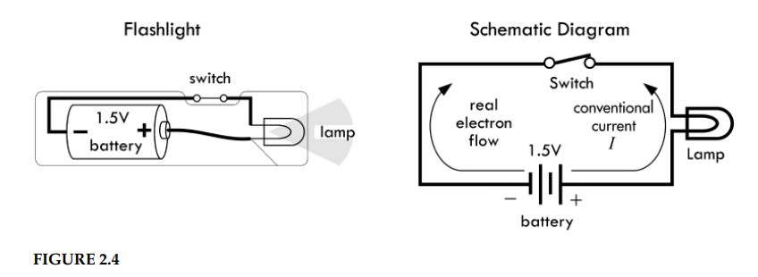
The Flashlight Circuit
This simple circuit illustrates all three quantities: voltage (battery), current (flow through loop), and power (consumed by lamp).
22

Slide 23
Formal Definition of the Volt
The volt can be defined from two perspectives:
Energy definition:
V = U / q → 1 Volt = 1 Joule/1 coulomb (1V = 1J/1C)
One volt means one joule of energy is transferred per coulomb of charge.
Power definition:
P = V × I → 1 Volt = 1 Watt / 1 Ampere (1V = 1W/1A)
One volt is the potential difference that produces one watt of power per ampere of current.
23

Slide 24
The Generalized Power Law
The most fundamental power equation in electronics:
P = V × I where P = power (watts), V = voltage (volts), I = current (amperes)
This works for ANY device — resistors, motors, LEDs, speakers, transistors, anything.
It comes from conservation of energy: the power delivered to a device equals the voltage across it times the current through it.
1 watt = 1 volt × 1 ampere = 1 joule per second
24

Slide 25
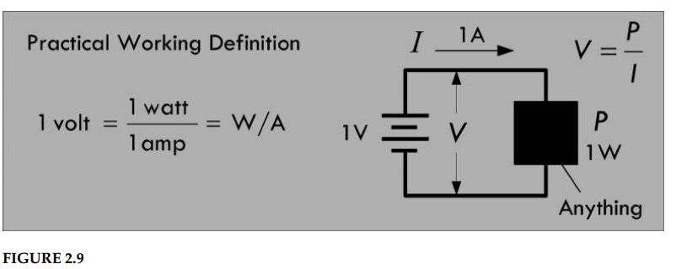
What P = VI Does & Doesn’t Tell You
What it tells you:
The total power consumed by any device
Quick measurements of voltage and current using just a voltmeter and ammeter
Works for any component — no need to know what’s inside
What it doesn’t tell you:
How the power is used? (light, heat)
The efficiency of the device
What’s happening internally
25

Slide 26
The Blackbox Thought Experiment
Consider a two-lead black box — an unknown circuit that may contain all sorts of devices, such as resistors, lamps, motors, or transistors.
If all we can do is measure the current entering the black box and the voltage across it (using an ammeter and voltmeter), we can apply the generalized power law:
Measure: V = 10 V, I = 0.1 A
P = V × I = 10 × 0.1 = 1 W total consumed power
Knowing how much power is pumped into the black box is incredibly useful — it allows for quick power consumption measurements and often simplifies circuit analysis.
26

Slide 27
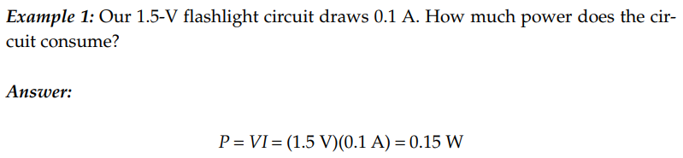
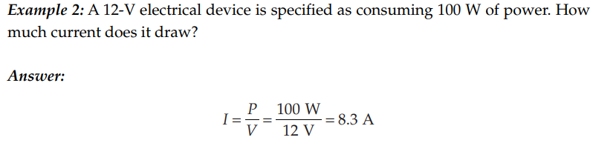
Calculating Current and Power in Circuits
27

Slide 28
PART 3
Resistance, Resistivity & Ohm's Law
Impedance to Electron Flow
28

Slide 29
Resistance — Definition
What is Resistance?
Free electrons in a conductor collide with lattice ions, impurities, and other electrons, which limits their motion. These microscopic impediments to electron flow are what we collectively call electrical resistance.
Ohm’s Discovery (1826)
George Simon Ohm found a linear relationship between applied voltage and resultant current through a material. He defined resistance as:
R = V / I
where R = resistance (ohms, Ω), V = voltage (volts), I = current (amperes)
29

Slide 30
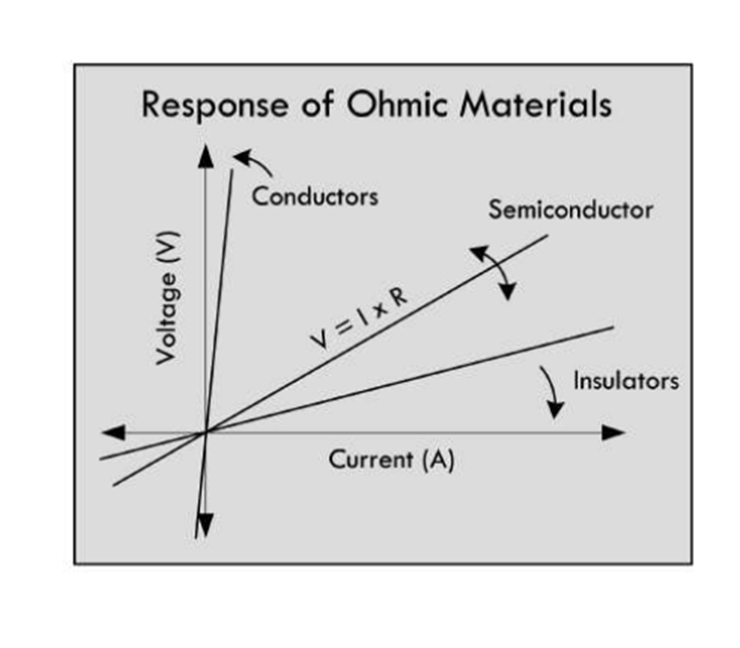
Ohm's Law
The Ohm (Ω)
One ohm is the resistance through which a current of 1 A flows when a voltage of 1 V is applied:
1 Ω = 1 V / 1 A
Important Limitation
Ohm’s law is not a universal law — it is an empirical statement
about the behaviour of certain materials.
It applies only to ohmic materials, whose resistance
remains constant over a range of applied voltages.
Non-ohmic materials do not follow Ohm’s law. For example,
a diode allows current to flow easily in one direction
but blocks it in the reverse direction — its resistance changes
with voltage.
30

Slide 31
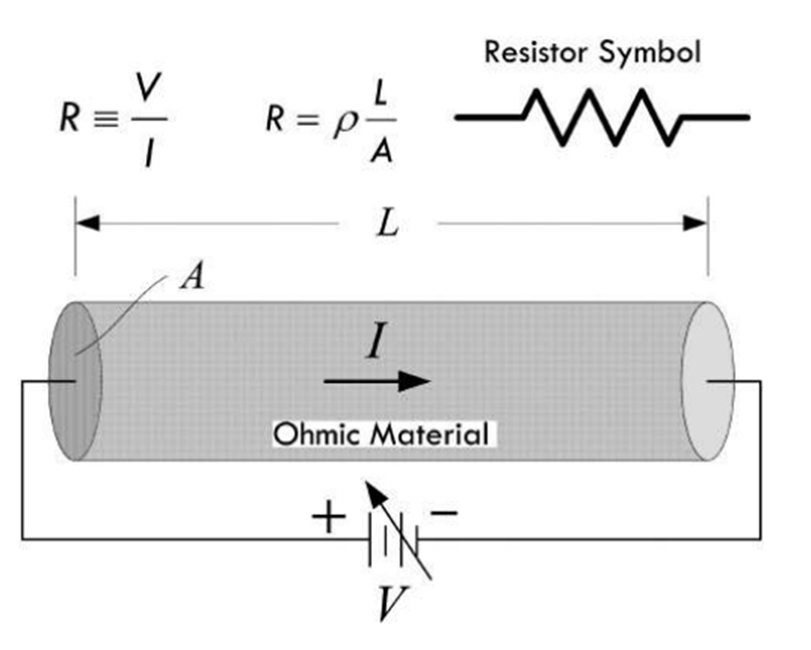
How Conductor Shape Affects Resistance
Length (L)
Doubling the length doubles resistance.
More lattice ions and imperfections along the path
means more electron collisions.
Cross-Sectional Area (A)
Doubling the area halves resistance. A wider conductor
distributes current over a greater volume, reducing electron
collisions and current density.
Current Density
Current density J = I / A describes the rate of current flow
per unit area. A thin wire has higher current density
than a thick wire carrying the same current, causing more collisions and greater resistance.
31

Slide 32
Resistivity (ρ)
Beyond shape — the material itself matters.
Resistivity ρ is a material property that is independent of the physical dimensions of the conductor. It tells us how strongly a material opposes current flow regardless of its size or shape.
Formula:
ρ = R × A / L
Where A = cross-sectional area, L = length, R = resistance of the sample.
Units: ohm-metres (Ωm)
Common examples: Copper ≈ 1.7 × 10⁻⁸ Ωm | Rubber ≈ 10¹³ Ωm | Silicon ≈ 10⁻³ to 10³ Ωm
32

Slide 33
Conductivity (σ)
The "Optimist’s" View of Resistance
Conductivity σ is simply the mathematical inverse of resistivity. Instead of measuring how badly a material conducts, it measures how well it conducts:
σ = 1 / ρ
Units: siemens, S = (Ωm)⁻¹
Ohm’s Law in terms of resistivity and conductivity:
J = σE (where J = current density, E = electric field)
Both resistivity and conductivity encode the same physical information. Copper (σ ≈ 6 × 10⁷ S/m) is an excellent conductor. Rubber (σ ≈10⁻¹³ S/m) is an excellent insulator.
33

Slide 34
Insulators, Conductors & Semiconductors
Category | Resistivity (Ωm) | Examples | Key Use
Conductors | ≈10⁻⁸ | Copper, Gold, Aluminium | Wires, PCB traces, contacts
Semiconductors | 10⁻⁵ to 10³ | Silicon, Germanium | Transistors, diodes, ICs
Insulators | ≈10¹² to 10¹⁶ | Rubber, Glass, Ceramic | Wire coatings, circuit boards
Semiconductor resistivity varies strongly with temperature and doping — the foundation of modern transistor and IC design.
34

Slide 35
PART 4
Heat & Power
Where Does the Electrical Energy Go?
35

Slide 36
Ohmic (Joule) Heating
The Generalized Power Law: P = V × I
This tells us the total power consumed by any device. It does not tell us how that power is used.
Joule Heating — Only for Pure Resistors
If a device is a pure resistor (100% ohmic), substituting Ohm’s law into P = VI gives:
P = I²R
P = V² / R
Called Ohmic heating, Joule heating, or I²R loss. This power is entirely converted into heat.
36

Slide 37
The Black Box Thought Experiment
Consider a two-lead "black box" containing an unknown circuit — resistors, lamps, motors, transistors, anything.
What we can measure:
Voltage across the box (voltmeter) and current entering it (ammeter)
Power consumed: P = V × I
Example:
V = 10 V, I = 0.1 A ➜ P = 10 × 0.1 = 1 W total consumed power
What we cannot determine from the outside:
How that 1 W is distributed between useful work and waste heat. For that, we must know what is inside.
37

Slide 38
Inside the Black Box — Where Does Power Go?
That 1 W of power could be used in many different ways depending on what's inside:
Motor — converts power into magnetic fields → rotation
Speaker — converts power into magnetic fields → sound waves
LED — converts power into photons → light
Resistor — converts ALL power into heat (Joule heating)
Chemical cell — converts power into stored chemical energy
Transformer — loses power to hysteresis and eddy currents in the core
P = VI tells you total power. Only opening the box tells you what it’s doing with that power.
38

Slide 39
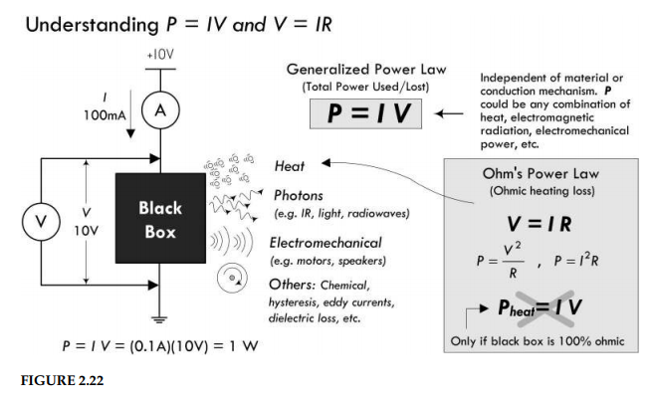
Inside the Black Box — Where Does Power Go?
39

Slide 40
The Black Box Analysis Trap
A Common Mistake:
❌ WRONG: Measuring V = 10 V, I = 0.1 A on a black box, then calculating:
R = V/I = 10/0.1 = 100 Ω
└→ P = I²R = (0.01)(100) = 1 W "of heat" ← INCORRECT ASSUMPTION
Why it’s wrong:
The "100 Ω" is an equivalent resistance — it describes the V/I ratio, not a physical resistor inside the box. If the box contains a motor, most power becomes rotation, not heat.
The Rule:
P = I²R and P = V²/R give heat dissipation ONLY for actual (pure) resistors. For any other device, use P = VI for total power.
40

Slide 41
Summary of Key Formulas
Quantity | Symbol | Unit | Formula(s) | Notes
Resistance | R | Ohm (Ω) | R = V/I | Opposition to current
Resistivity | ρ | Ωm | ρ = RA/L | Material property only
Conductivity | σ | S = (Ωm)⁻¹ | σ = 1/ρ | Inverse of resistivity
Power (general) | P | Watt (W) | P = VI | Any device
Joule Heating | P | Watt (W) | P = I²R = V²/R | Resistors only!
41

Slide 42
Summary of Key Quantities
Quantity | Symbol | Unit | Formula | Definition
Voltage | V | Volt (V) | V = IR, V = P/I | Energy per unit charge
Current | I | Ampere (A) | I = ΔQ/Δt, I = V/R | Charge flow per second
Resistance | R | Ohm (Ω) | R = V/I | Opposition to current
Power | P | Watt (W) | P = VI | Energy per second
42

